Slide 1

Boston Housing: relation between age and tax rate & the number of rooms
Winnie uyen nguyen
Data analysis

Slide 2
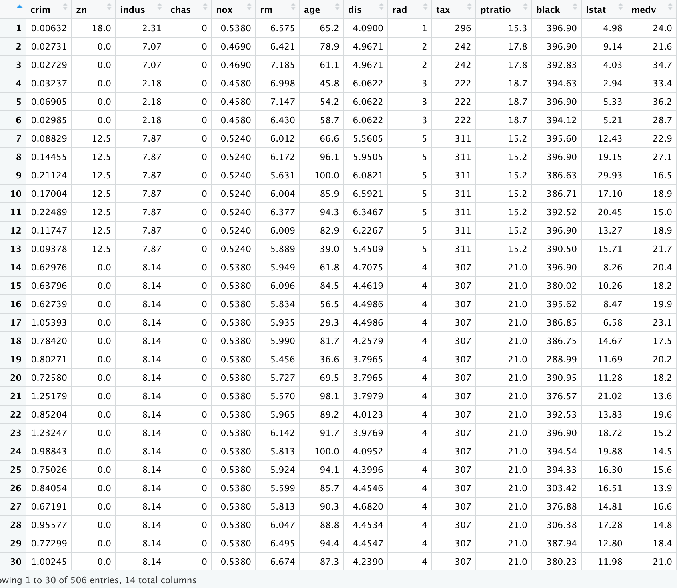
Topic: Boston Housing
The relationship of housing features: tax rate and the number of rooms to predict the age of the house (specifically which house built before 1940)
BostonHousing Data in library MASS:
+ 506 rows & 14 columns

Slide 3
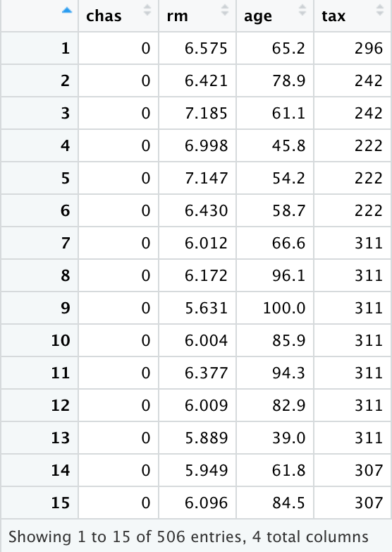
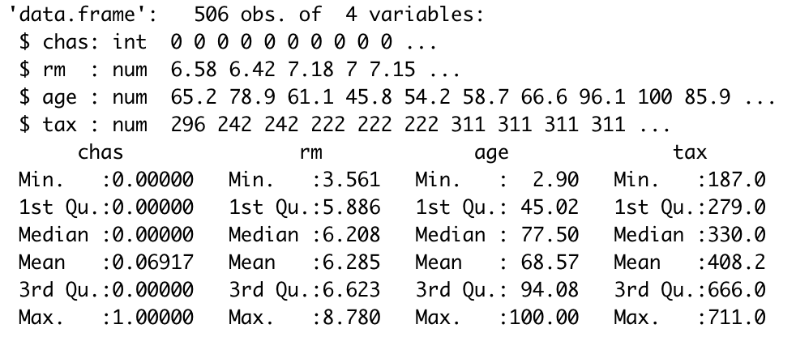
Data frame using in the project/topic:
New data frame extracted from BostonHousing contains 506 rows x 4 cols
Overview about data structure:
+ str() & summary()

Slide 4
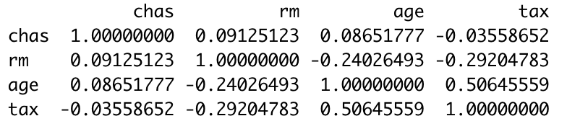
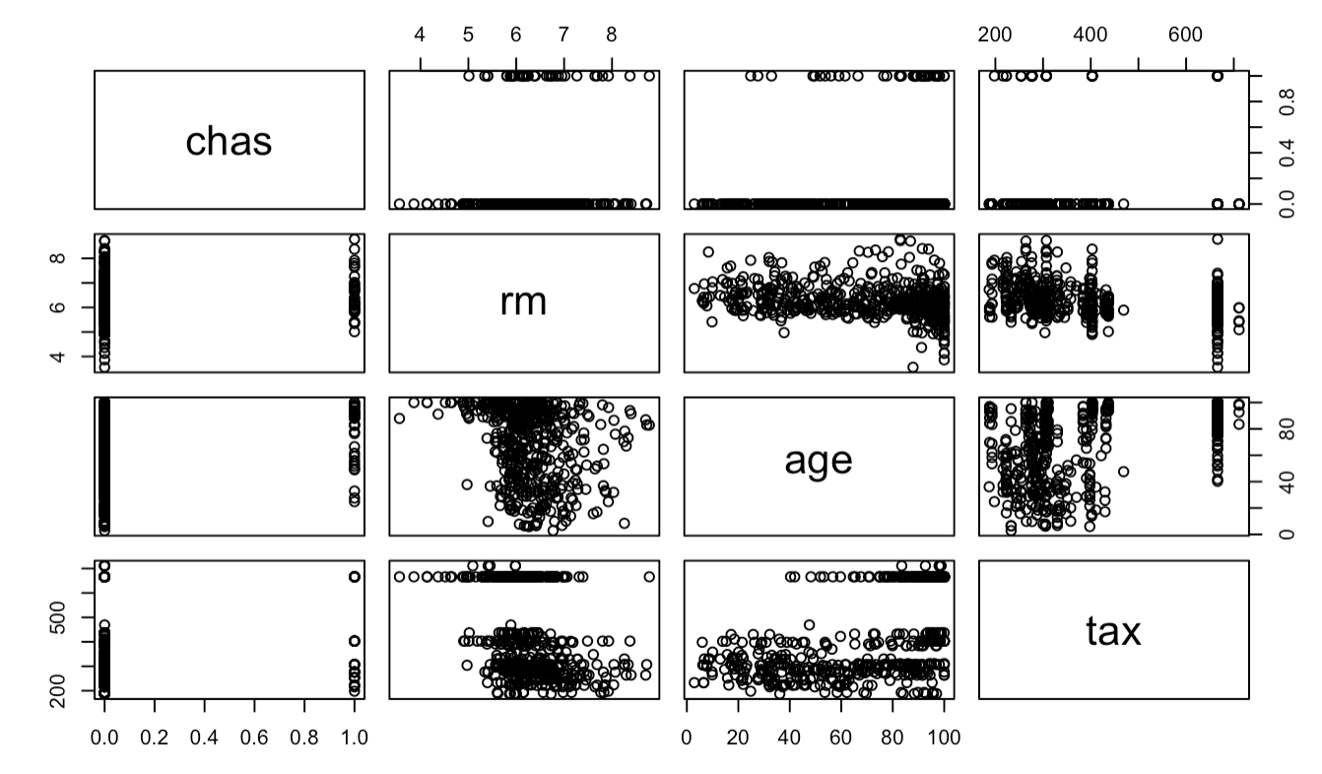
Correlation Test among variables: Char: Charles River dummy variable (=1 if track bounds river; 0 otherwise) rm: average number of rooms per dwelling age: proportion of owner-occupied units built prior to 1940 tax: full-value property-tax rate per $10,000
Correlation test of 4 variables
Plot matrix showing scatterplots for each variable
Meaning:
+ The average number of rooms has a negative coefficient with age (dependent variable)
+ While the tax rate has a positive coefficient with age (dependent variable)

Slide 5
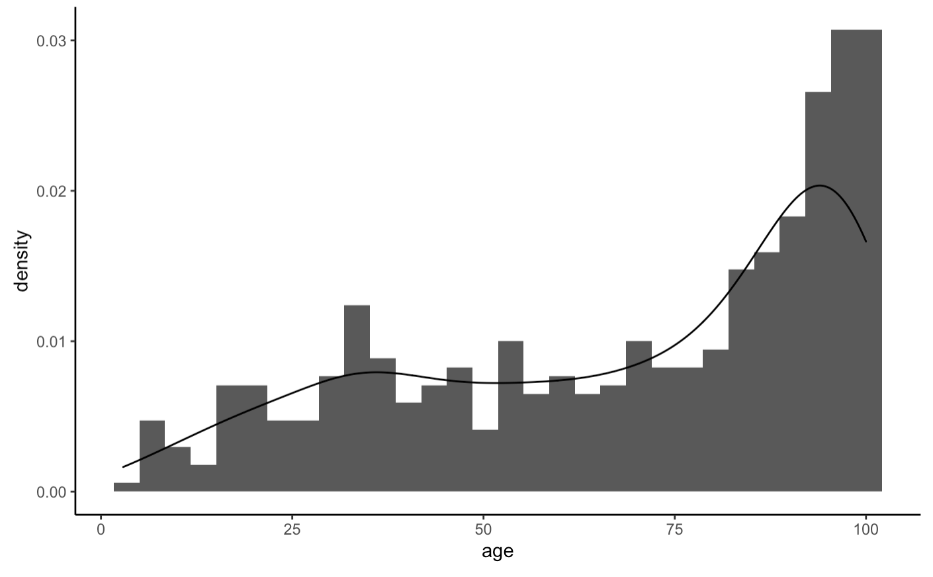
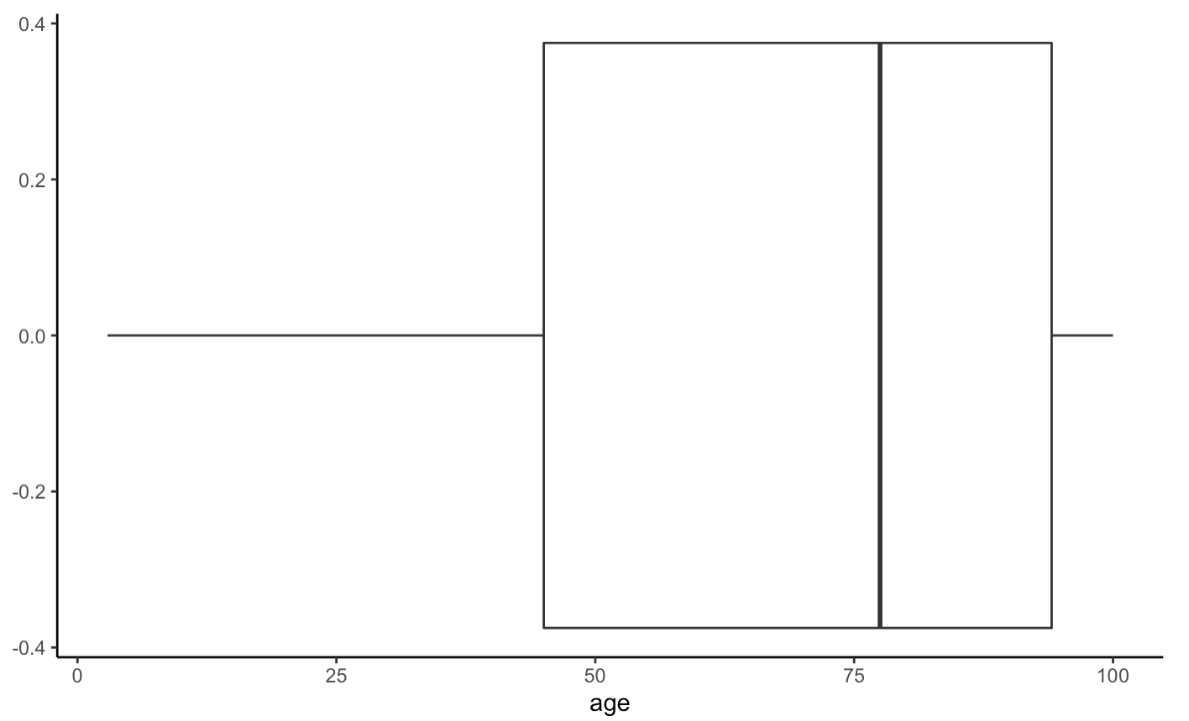
Visualize each variable (Histogram & Boxplot): Age

Slide 6
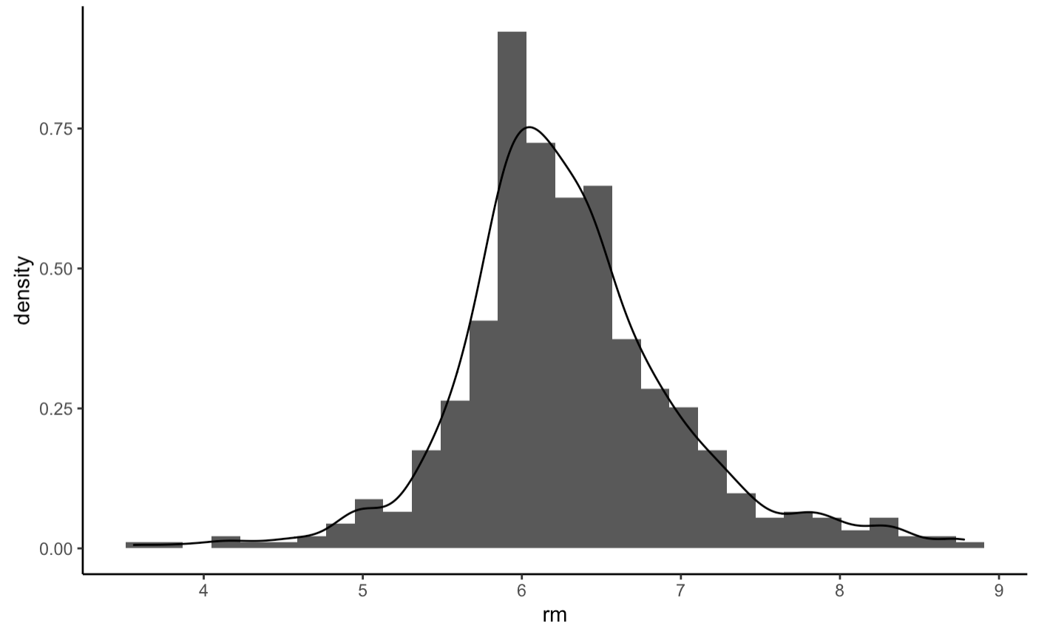
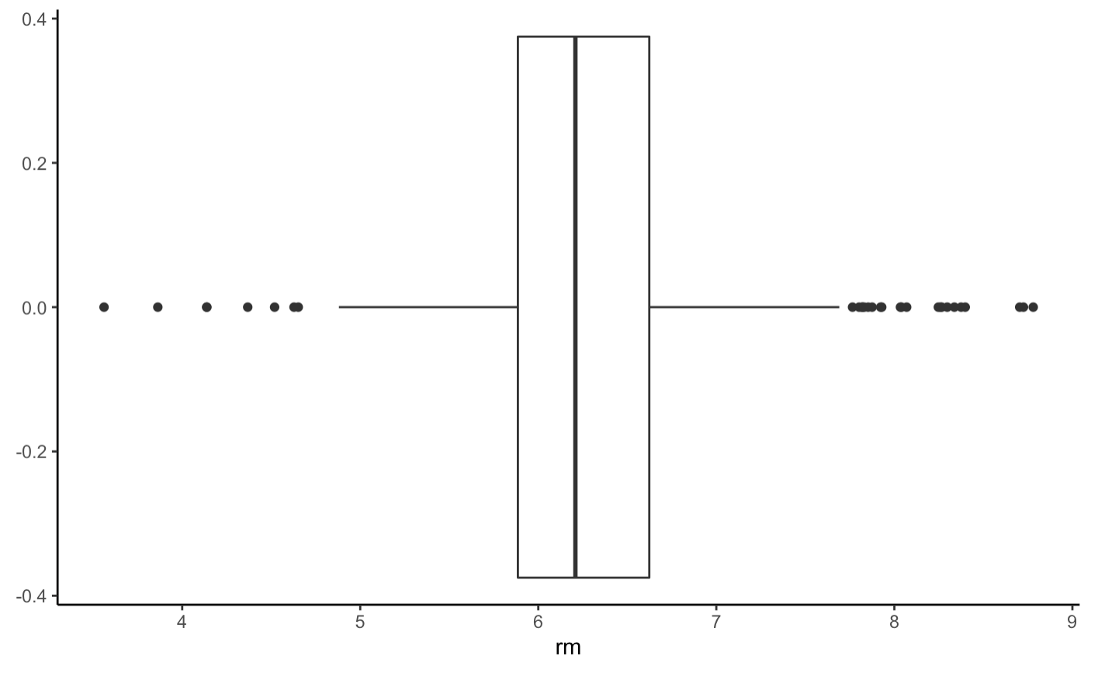
Visualize each variable (Histogram & Boxplot): rm

Slide 7
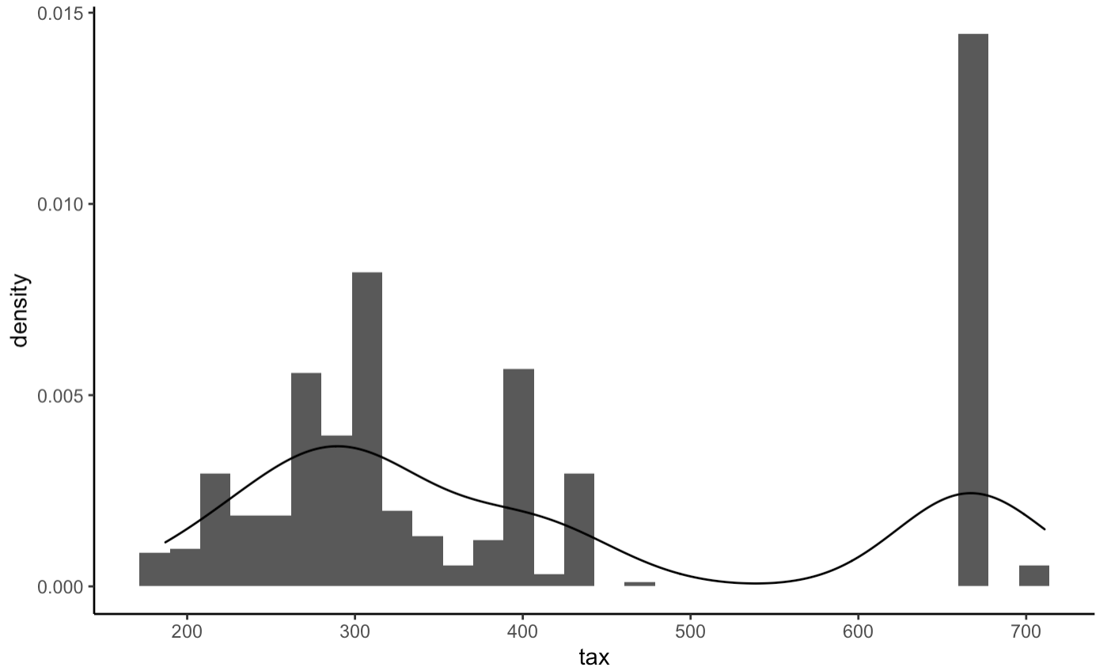
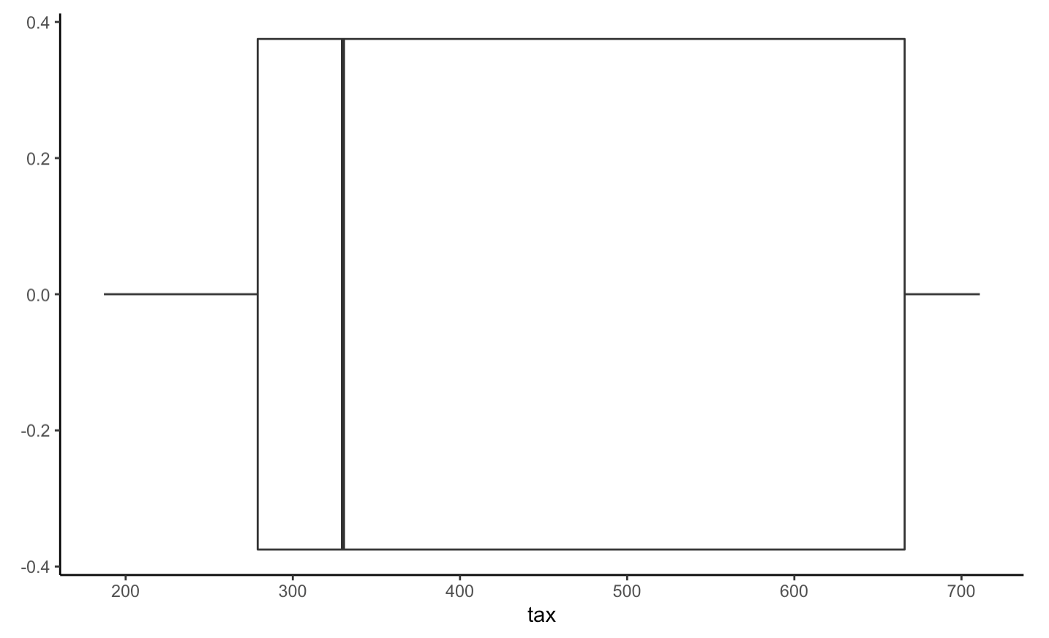
Visualize each variable (Histogram & Boxplot): tax

Slide 8
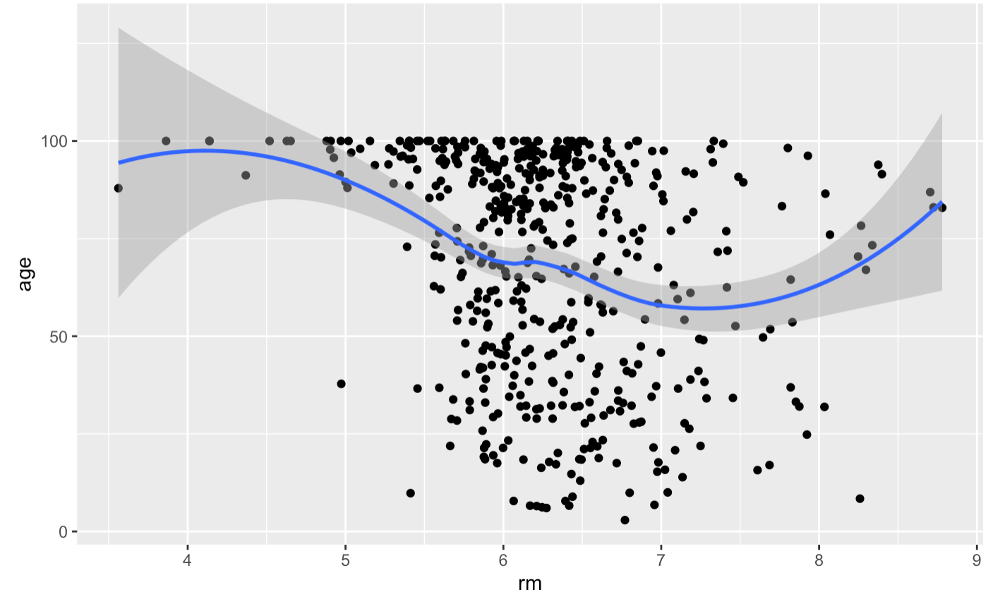
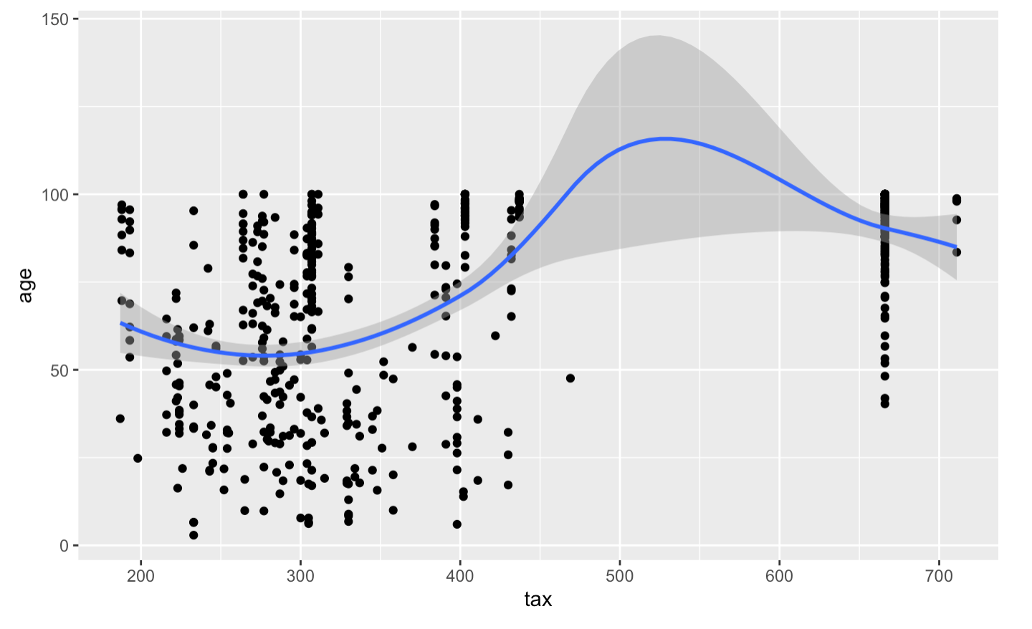
Scatter diagram between dependent var and independent var
Age & rm
Age & tax

Slide 9
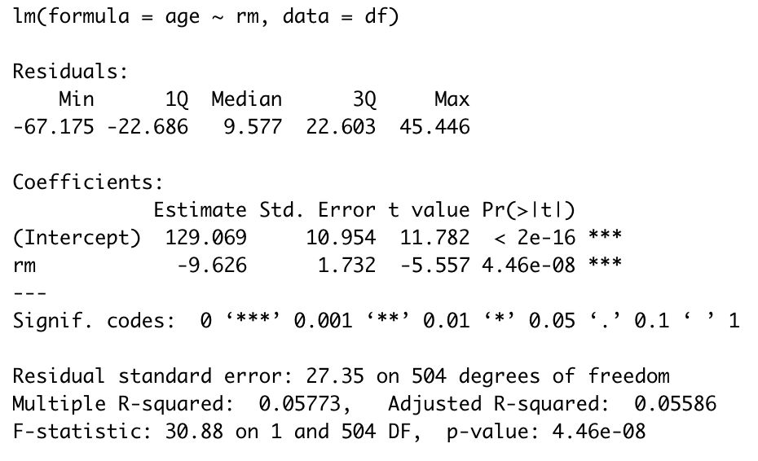
Single Linear Regression
Model 1: Predict the proportion of house built before 1940 given by the average room numbers in house
+ Negative coefficient
+ Estimated function:
Age = 129.069 – 9.626 * rm
Eg: rm = 6.575
+ Estimated result = 65.78
+ Actual result (= Estimated result + e) = 65.2
------
+ P-value (less than 5%): significant coefficient for rm
+ Adjusted R-squared: too low (~5.77%)
-> independent variable (rm) can’t explain the dependent variable (age)

Slide 10
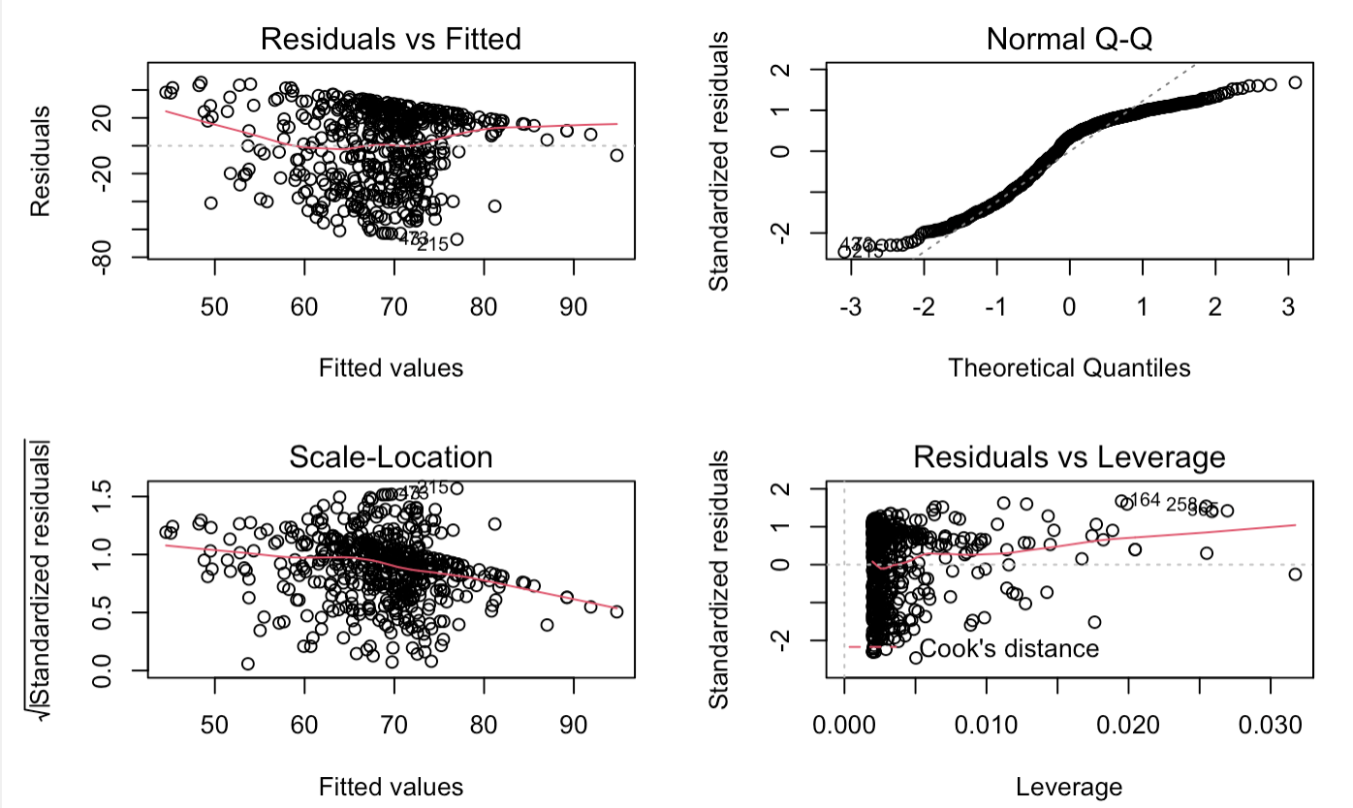
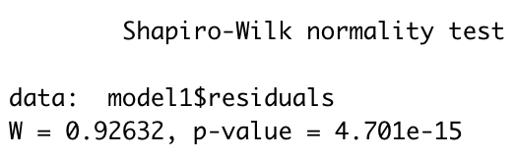
Checking the regression model1 assumptions on residuals (Plot & Shapiro Test)
1) Plot(model1)
+ Residuals vs Fitted plot: the red line is slightly curved; all the fitted value are scattered around the middle of the red line -> NON-LINEARITY relationship
+ Normal Q-Q: not a good alignment because the residuals considerably move off at the end of the line
+Scale-Location: residuals are well spread above and below the horizontal line however the beginning of the line has fewer points -> less variance
-> This regression has Heteroscedasticity, showing a not good linear regression
2) Shapiro test shows skewed data
Notes:
General: https://rpubs.com/Abhilash333/396604
Detail explain of each plot: https://rpubs.com/iabrady/residual-analysis
Residuals: Homoscedasticity (Phuong sai sai so khong doi -> good regression) >< Heteroscesdasticity (Phuong sai sai so thay doi -> not good)
Sharpio Wilk Test: https://www.sheffield.ac.uk/polopoly_fs/1.885202!/file/95_Normality_Check.pdf

Slide 11
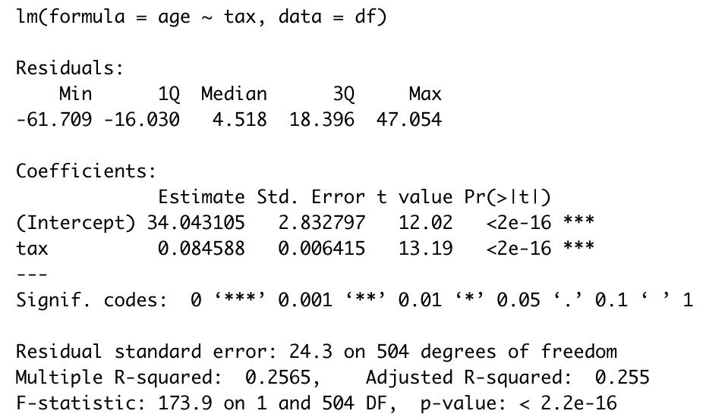
Single Linear Regression
Model 2: Predict the proportion of house built before 1940 given by the tax rate
+ Positive coefficient
Estimated function:
Age = 34.04 + 0.085 * tax
Eg: tax = 296
+ Estimated result = 59.2
+ Actual result (= Estimated result + e)
= 65.2
------
+ P-value (less than 5%): significant coefficient for tax
+ Adjusted R-squared: quite low (~25.5%)
-> independent variable (rm) can only explain 25.5% the dependent variable

Slide 12
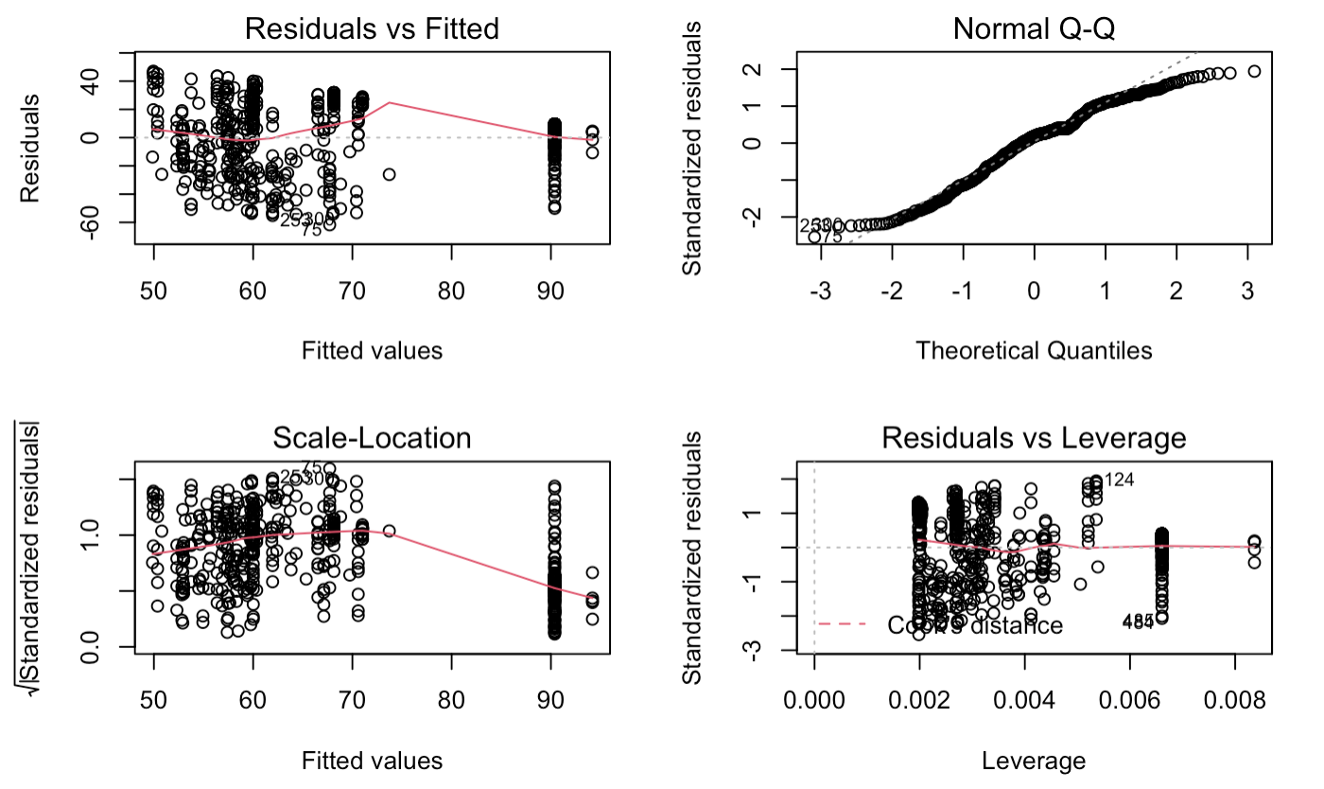
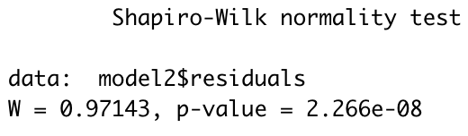
Checking the regression model2 assumptions on residuals (Plot & Shapiro Test)
Plot(model2) & Shapiro Test
-> Show this regression has heteroscedasticity, skewed data and not a good linear regression

Slide 13
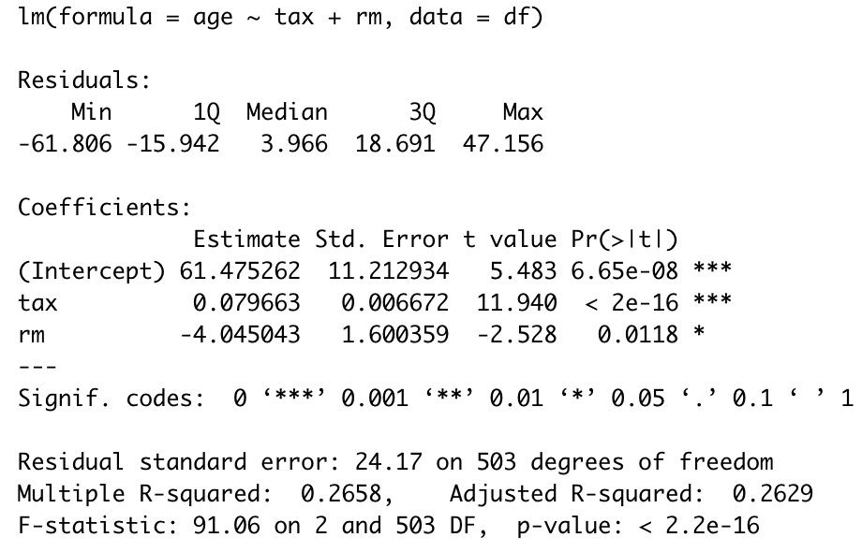
Multi-variables Linear Regression
Model 3: Predict the proportion of house built before 1940 given by the tax rate & the average number of rooms
Estimated function:
Age = 61.48 + 0.08 * tax – 4.05 *rm
Eg: tax = 296 & rm = 6.575
+ Estimated result = 58.53
+ Actual result (= Estimated result + e)
= 65.2
------
+ P-value (less than 5%): significant coefficient for both tax and rm
+ Adjusted R-squared: quite low (~26.3%)
-> independent variables (tax & rm) can only explain 26.3% the dependent variable (age)

Slide 14
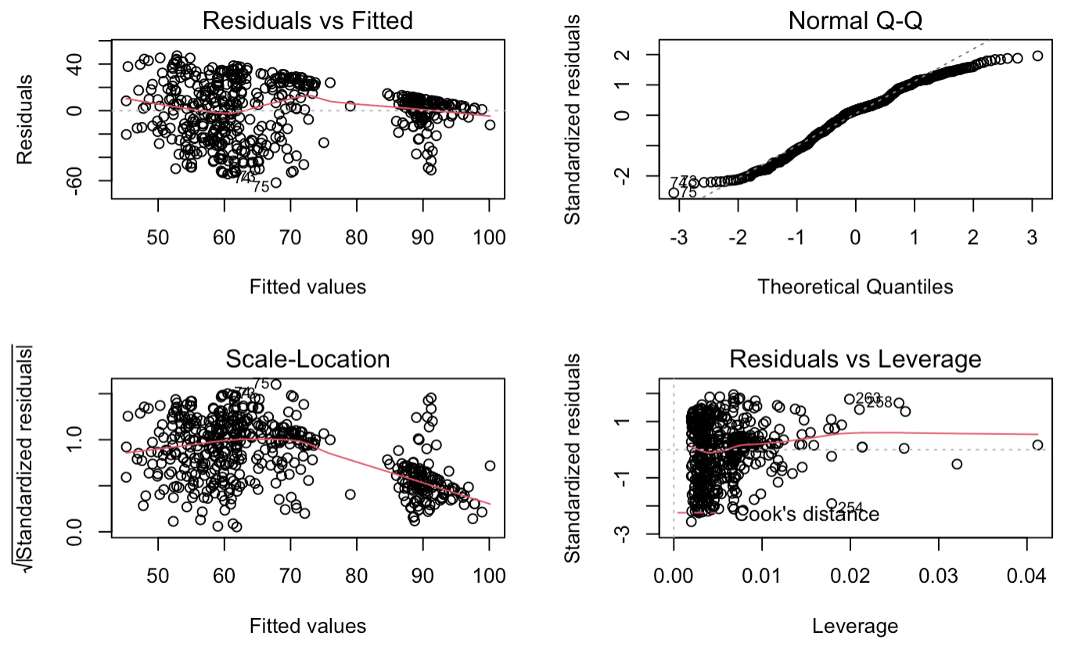
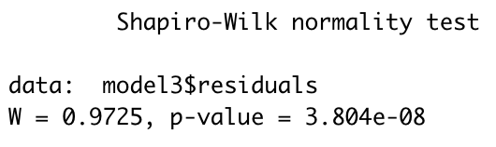
Checking the regression model3 assumptions on residuals (Plot & Shapiro Test)
Plot(model3) & Shapiro Test
-> Show this regression has:
+heteroscedasticity
+ skewed data + not a good linear regression

Slide 15
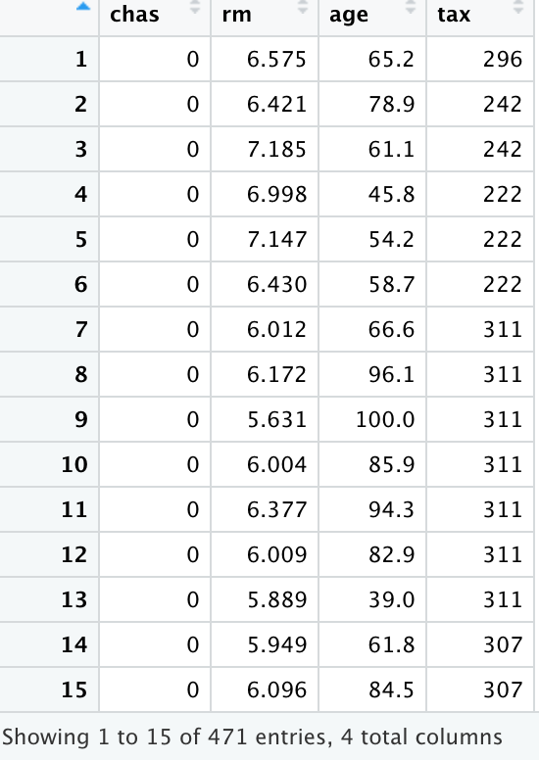
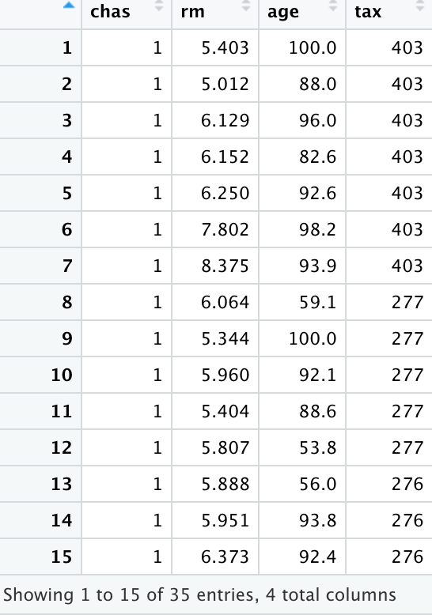
Improve the accuracy of model using dummy variable CHAS
Chas == 1: Df2 has 35 rows x 4 cols
Chas == 0: Df3 has 471 rows x 4 cols

Slide 16
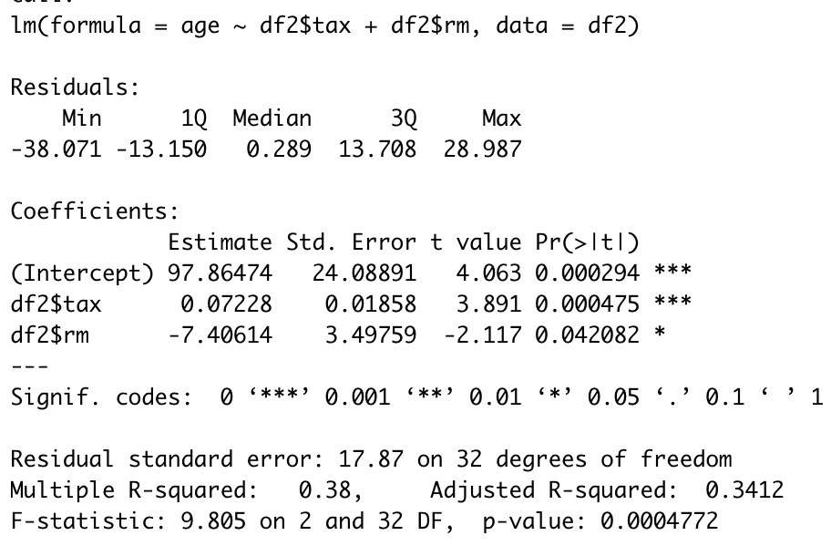
Multi-variables Linear Regression
Model 3.1: Predict the proportion of house built before 1940 given by the tax rate & the average number of rooms (with CHAS ==1)
Estimated function:
Age = 97.86 + 0.072 * tax – 7.41 *rm
------
+ P-value (less than 5%): significant coefficient for both tax and rm
+ Adjusted R-squared: 34.12%
-> This model increases the percentage which independent variables explain the dependent variable (comparing with 26.3% in model 3)

Slide 17
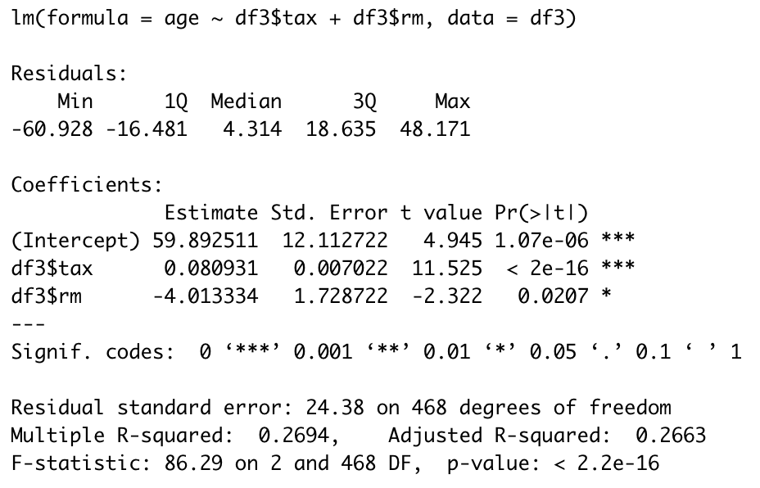
Multi-variables Linear Regression
Model 3.2: Predict the proportion of house built before 1940 given by the tax rate & the average number of rooms (CHAS == 0)
Estimated function:
Age = 59.9 + 0.08 * tax – 4.01 *rm
------
+ P-value (less than 5%): significant coefficient for both tax and rm
+ Adjusted R-squared: 26.63%
-> This model doesn’t increase the percentage which independent variables explain the dependent variable (comparing with 26.3% in model 3)

